Slide 1
Publication Rates: Analysis of Faculty Research @ UR[ichmond] Data Analytics Bootcamp, Project 1 Kristine Nolin and Carol Wittig June 15, 2019
Notes:
Kristine – start and introduce

Slide 2
OUTLINE OF PRESENTATION:
Questions and Motivation
Data
Exploration and Cleanup
Analysis
Implications of our Findings
Limitations of Data Used
Notes:
Kristine walks through outline

Slide 3



Motivation
Notes:
Share each of our motivation

Slide 4

Questions
How prolific are UR faculty in journal scholarship?
How many journal articles do UR faculty publish?
What journals do they publish in?
How many different journals?
How many articles are published in each journal?
What authors (departments) publish the most?
Who & what do these counts miss?
Notes:
Carol – overview questions

Slide 5
Getting Started with Data
STEP 1
STEP 2
STEP 3
STEP 3
Locating data:
CrossRef API data: 6m
Missing data fields
Another data source needed…
Use Web of Science – 4,700 - CSV import
Manipulate and Analyze Data
-GroupBy!!
-Bar Charts
-Line Graphs
-Pie Chart
Realize all that isn’t there!
Notes:
Carol – walk through fast

Slide 6
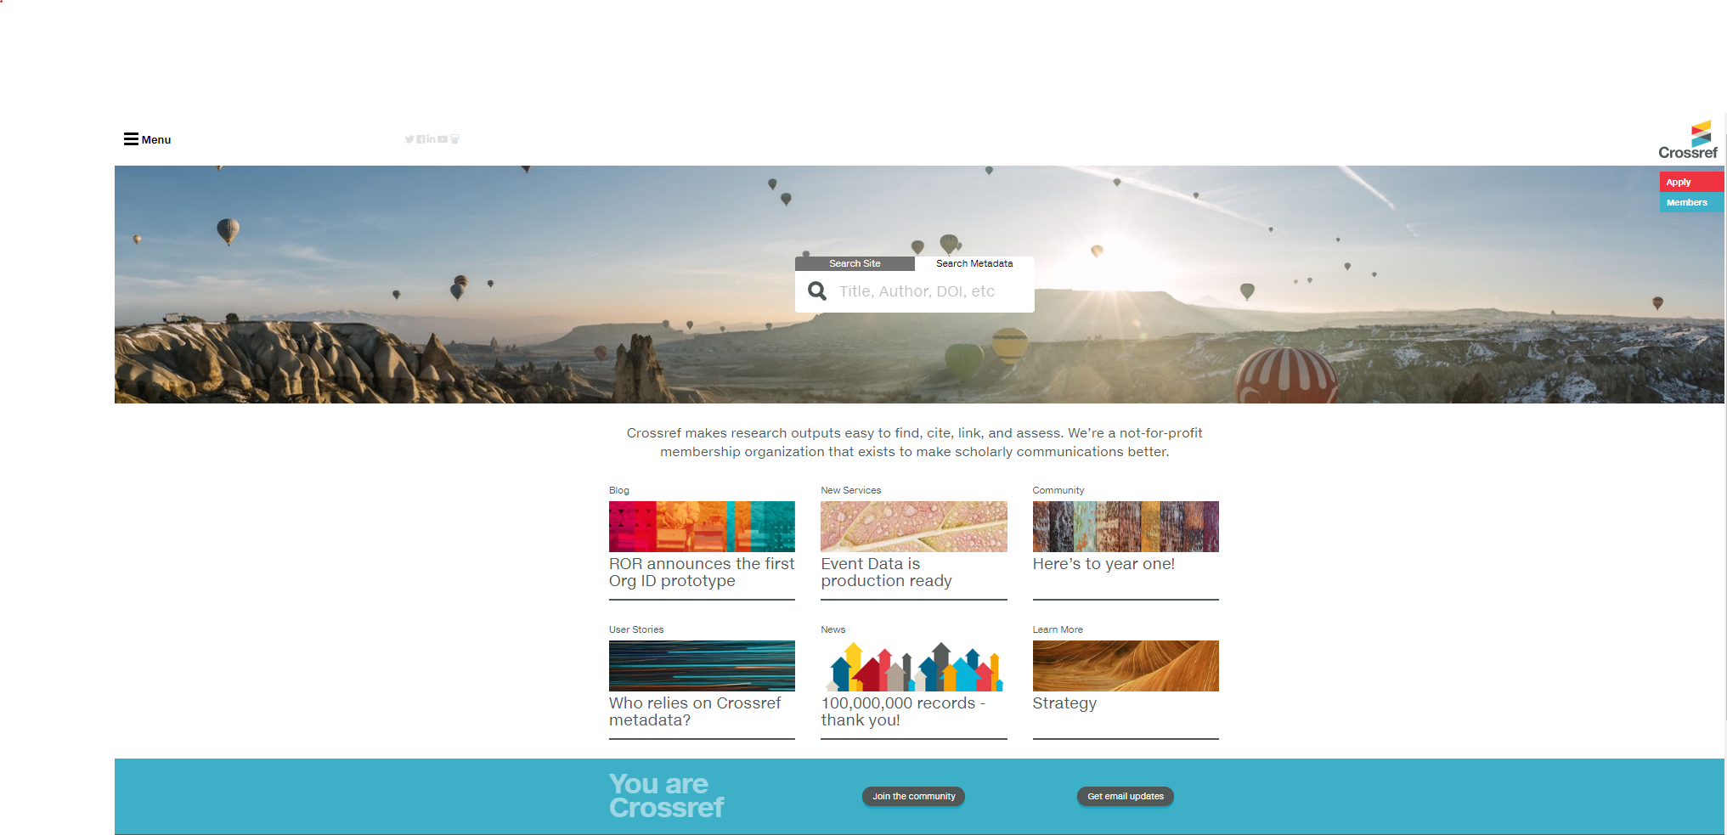
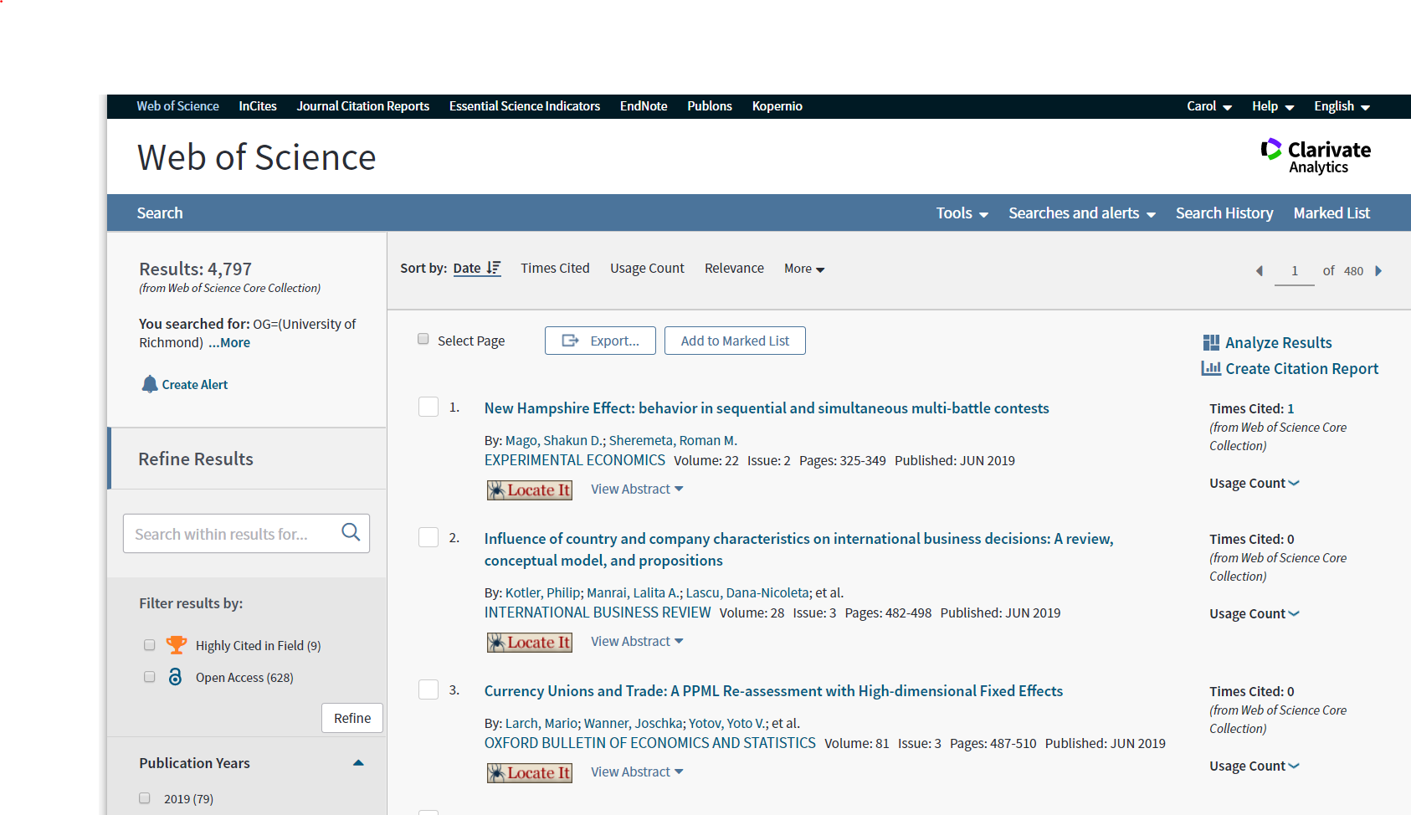
Data:
CrossRef
Web of Science
Notes:
Carol – walk through fast

Slide 7
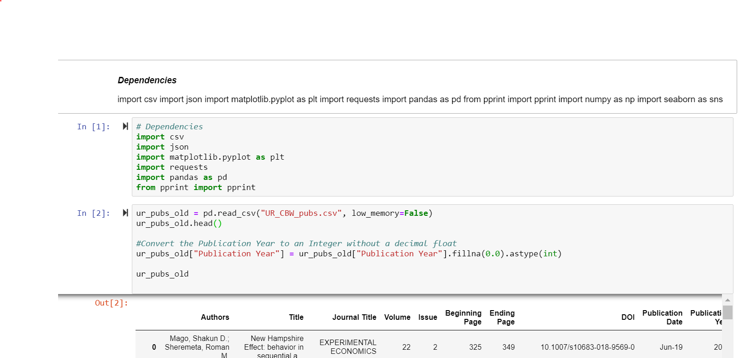
How much is published?
Journals indexed in Web of Science
1976-present
Affiliation: University of Richmond
4,708
Notes:
Carol - issues

Slide 8

Analysis
JOURNAL Information:
What journals are faculty publishing in?
How many different journals are there?
How many articles are published in each journal?
AUTHOR Information:
What authors (departments) publish the most?
Notes:
Carol – talk about journals -- CLICK ON JUPYTER and Kristine walks through code

Slide 9
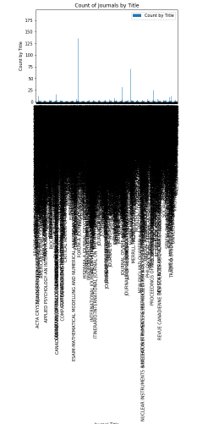
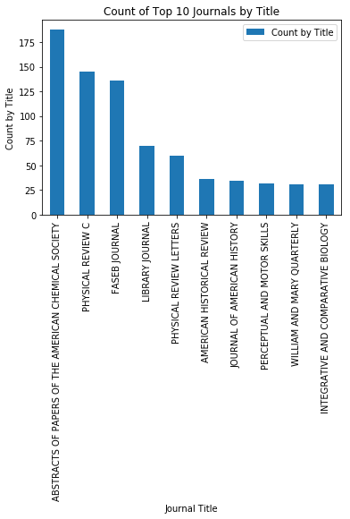
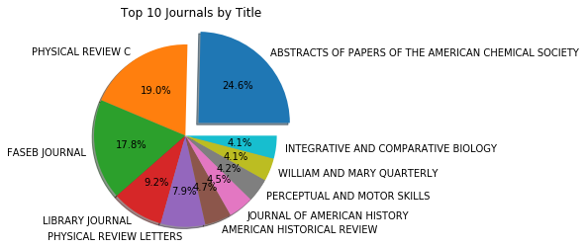
Top 10 Journal Titles By Publication
Oops…all journals isn’t a pretty visual…
Notes:
Carol – talk about oops

Slide 10
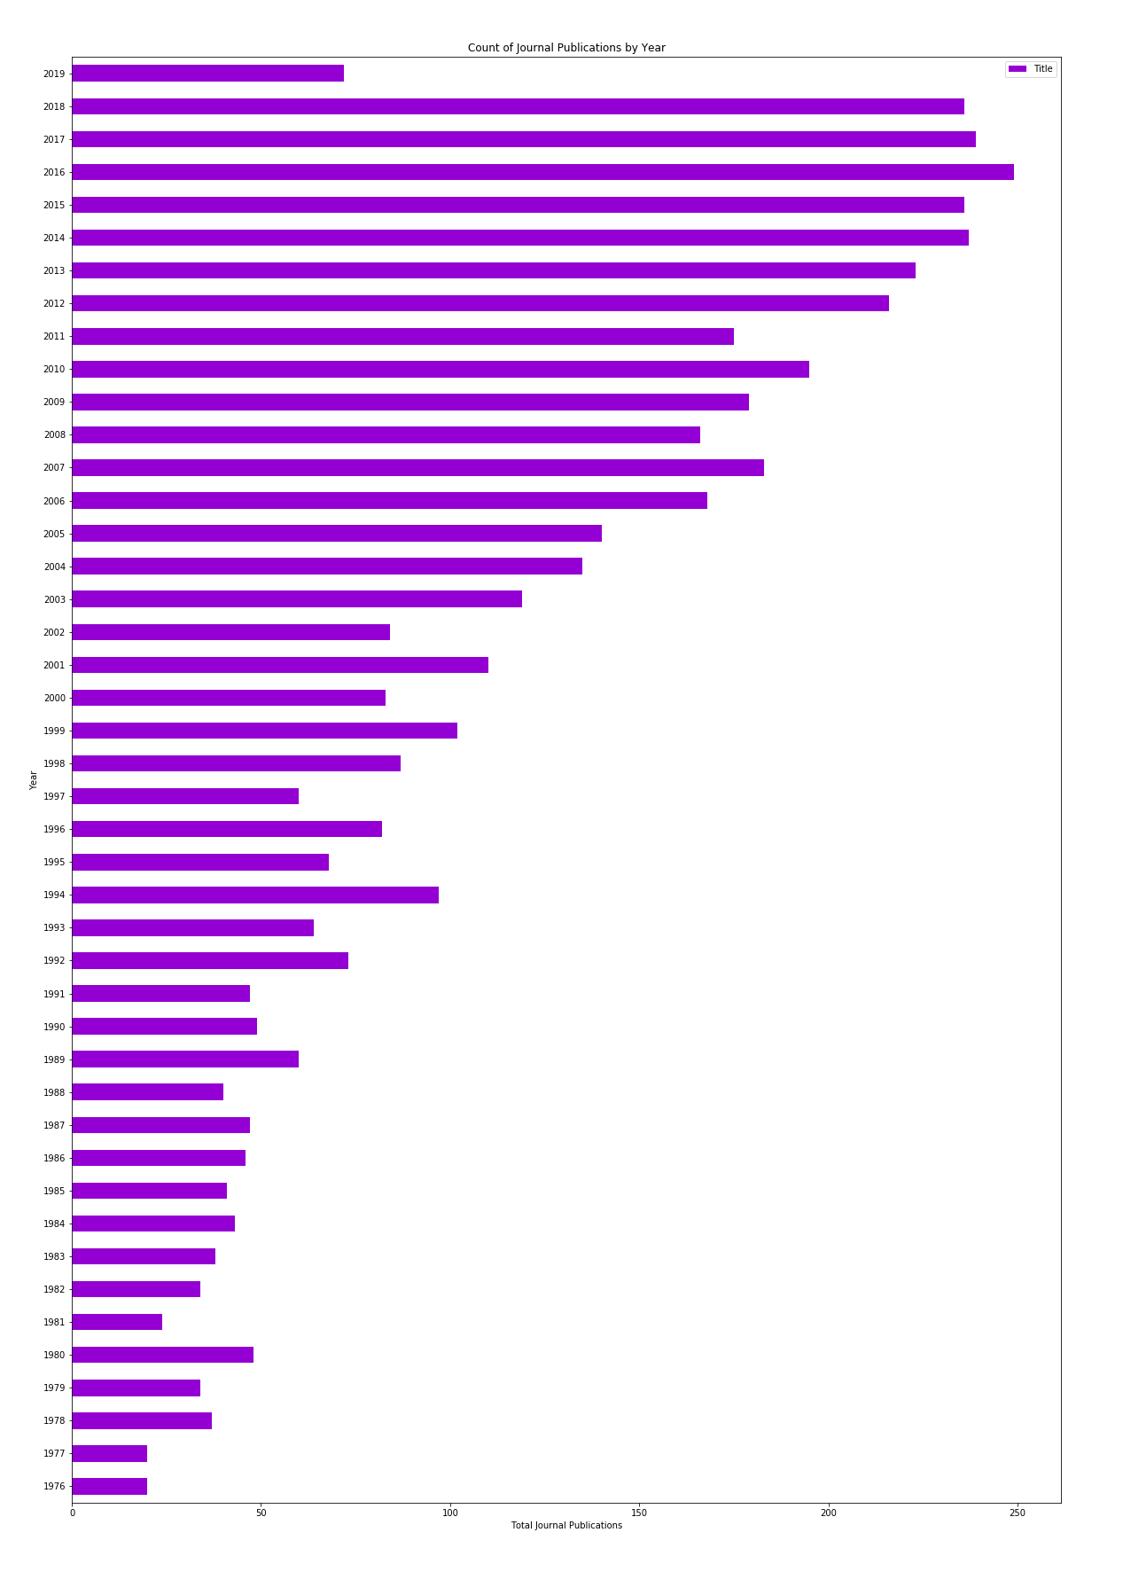
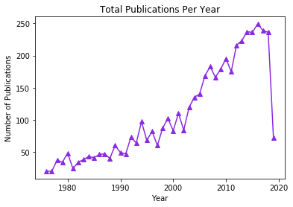
Total Publications By Year
Notes:
Carol overview totals

Slide 11
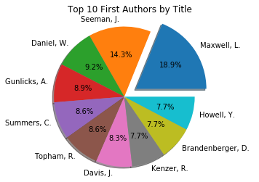
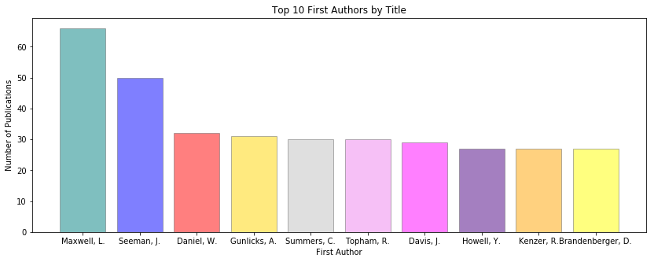
Top 10 Authors – Number of Journal Publications
Notes:
Kristine takes over and talks about Authors

Slide 12

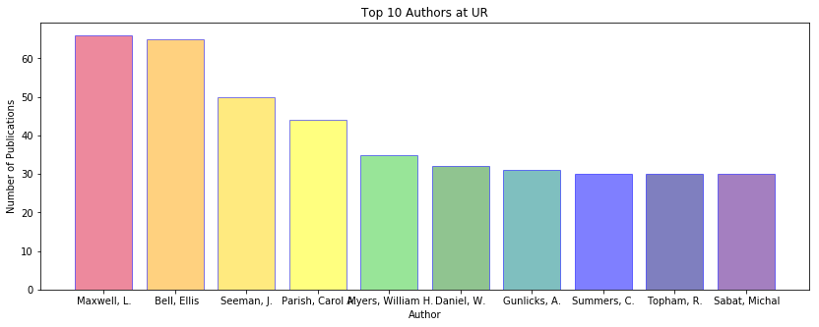
Top 10 Authors – Total # of Journal Publications
Notes:
Kristine - authors

Slide 13
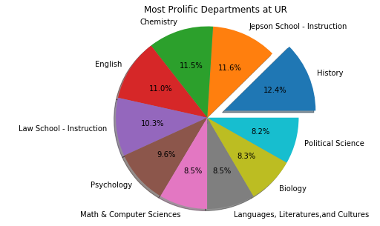
Top Departments – Total # of Journal Publications
By First Author
Notes:
Kristine

Slide 14
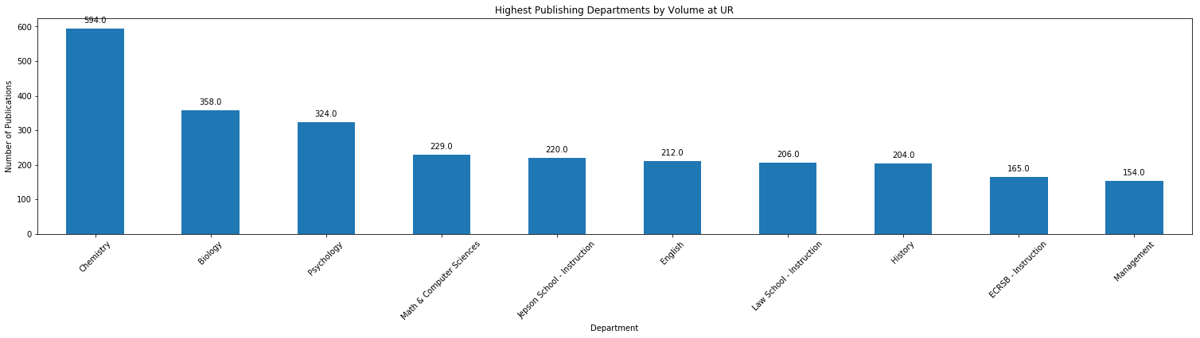
Top Departments – Total # of Journal Publications
Total Authors
Notes:
Kristine

Slide 15

BUT…what DO the numbers really mean?
Web of Science Includes
Authors?
Publications?
Formats?
Research?
Book Reviews?
Conferences?
Science & STEM
Humanities
Notes:
Carol - issues

Slide 16

Who & What Do These Counts Miss?
and…Where’s Kristine?
Notes:
Carol – last ? Who isn’t counted and why – Kristine – explain about students

Slide 17
What’s Next?
APIS! ~WofScience and other database vendors…
Some try to charge $$$
Multi-university comparisons of author output
Text Analysis of pdf article contents
ngrams and topic modeling

Slide 18

Questions?

